Slide 1
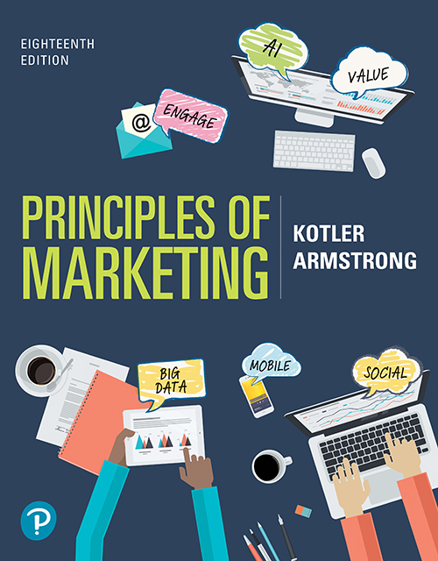
Principles of Marketing
Eighteenth Edition
Chapter 7
Customer Value-Driven Marketing Strategy: Creating Value for Target Customers
Copyright © 2021, 2018, 2016 Pearson Education, Inc.
Notes:
If this PowerPoint presentation contains mathematical equations, you may need to check that your computer has the following installed:
1) Math Type Plugin
2) Math Player (free versions available)
3) NVDA Reader (free versions available)

Slide 2
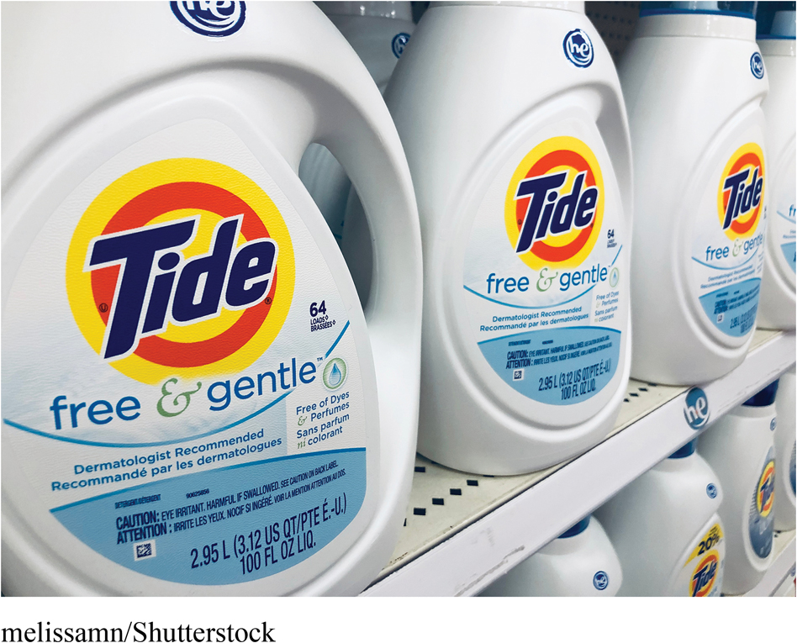
P&G: Competing with Itself—and Winning
By offering brands and sub-brands that target specific segments of detergent preferences, here Tide Free & Gentle, Tide offers a unique value proposition to each distinct customer segment.
Notes:
Procter & Gamble (P&G) invented brand management. P&G builds big brands, including 23 brands with annual revenues between $1 billion and $10 billion which generally hold the number one or two position in their categories. P&G’s brands compete with each other but, because of smart segmentation and positioning, when P&G competes against itself, it wins.

Slide 3
Learning Objectives
7.1 Define the major steps in designing a customer-driven marketing strategy: market segmentation, targeting, differentiation, and positioning.
7.2 List and discuss the major bases for segmenting consumer and business markets.
7.3 Explain how companies identify attractive market segments and choose a market-targeting strategy.
7.4 Discuss how companies differentiate and position their products for maximum competitive advantage.

Slide 4
Learning Objective 1
Define the major steps in designing a customer-driven marketing strategy: market segmentation, targeting, differentiation, and positioning.

Slide 5
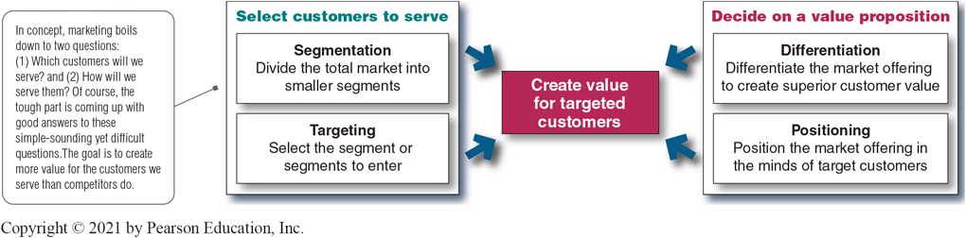
Customer-Driven Marketing Strategy
Notes:
Companies today recognize that they cannot appeal to all buyers in the marketplace—or at least not to all buyers in the same way. They must design customer-driven marketing strategies that build the right relationships with the right customers.
Thus, most companies have moved away from mass marketing and toward target marketing: identifying market segments, selecting one or more of them, and developing products and marketing programs tailored to each.
Figure 7.1 shows the four major steps in designing a customer-driven marketing strategy:
Segmentation
Targeting
Differentiation
Positioning
We will discuss each of these steps in turn.
Long Description:
The details depicted in the figure are as follows:
The text "Create value for targeted customers" is depicted in the center of the figure. The four steps listed around it are as follows:
Select customers to serve:
Segmentation: Divide the total market into smaller segments
Targeting: Select the segment or segments to enter
Decide on a value proposition
Differentiation: Differentiate the market offering to create superior customer value
Positioning: Position the market offering in the minds of target customers
A note reads "In concept, marketing boils down to two questions: 1. Which customers will we serve? and 2. How will we serve them? Of course, the tough part is coming up with good answers to these simple-sounding yet difficult questions. The goal is to create more value for the customers we serve than competitors do.

Slide 6
Learning Objective 2
List and discuss the major bases for segmenting consumer and business markets.

Slide 7
Market Segmentation (1 of 14)
Market segmentation requires dividing a market into smaller segments with distinct needs, characteristics, or behaviors that might require separate marketing strategies or mixes.
Notes:
Buyers in any market differ in their wants, resources, locations, buying attitudes, and buying practices. Through market segmentation, companies divide large, heterogeneous markets into smaller segments that can be reached more efficiently and effectively with products and services that match their unique needs.

Slide 8
Market Segmentation (2 of 14)
Segmenting consumer markets
Segmenting business markets
Segmenting international markets
Requirements for effective segmentation
Notes:
In Learning Objective 2, we will discuss four important segmentation topics: segmenting consumer markets, segmenting business markets, segmenting international markets, and the requirements for effective segmentation.

Slide 9
Market Segmentation (3 of 14)
Segmenting Consumer Markets
Geographic segmentation
Demographic segmentation
Psychographic segmentation
Behavioral segmentation
Notes:
There is no single way to segment a market. A marketer has to try different segmentation variables, alone and in combination, to find the best way to view market structure. This visual outlines variables shown in Table 7.1 that might be used in segmenting consumer markets.

Slide 10
Market Segmentation (4 of 14)
Segmenting Consumer Markets
Geographic segmentation divides the market into different geographical units such as nations, regions, states, counties, cities, or even neighborhoods.
Notes:
A company may decide to operate in one or a few geographical areas or operate in all areas but pay attention to geographical differences in needs and wants.
Many companies today are localizing their products, advertising, promotion, and sales efforts to fit the needs of individual regions, cities, and neighborhoods.
For example, Domino’s Pizza, the nation’s largest pizza delivery chain, keeps its marketing and customer focus decidedly local. Customers anywhere in the nation can use the online platform or smartphone app to track down local coupon offers, locate the nearest store with a GPS store locator, and quickly receive a freshly-made pizza. They can even use Domino’s Pizza Tracker to follow their pies locally from store to door.

Slide 11
Market Segmentation (5 of 14)
Segmenting Consumer Markets
Demographic segmentation divides the market into segments based on variables such as age, life-cycle stage, gender, income, occupation, education, religion, ethnicity, and generation.
Notes:
Demographic factors are the most popular bases for segmenting customer groups. One reason is that consumer needs, wants, and usage rates often vary closely with demographic variables. Demographic variables are easier to measure than most other types of variables.
Even when marketers first define segments using other bases, such as benefits sought or behavior, they must know a segment’s demographic characteristics to assess the size of the target market and reach it efficiently.

Slide 12
Market Segmentation (6 of 14)
Segmenting Consumer Markets
Age and life-cycle stage segmentation divides a market into different age and life-cycle groups.
Gender segmentation divides a market into different segments based on gender.
Income segmentation divides a market into different income segments.
Notes:
Consumer needs and wants change with age. Some companies offer different products or use different marketing approaches for different age and life-cycle groups. Other companies offer brands that target specific age or life-stage groups. For example, Amazon targeted a younger tablet market for using the Kindle Fire tablet, introducing FreeTime Unlimited, a multimedia subscription service targeted toward 3- to 8-year-olds. Marketers must be careful to guard against stereotypes when using age and life-cycle segmentation.
Gender segmentation has long been used in clothing, cosmetics, toiletries, and magazines. For example, P&G was among the first to use gender segmentation with Secret, a brand specially formulated for a woman’s chemistry, and packaged and advertised to reinforce the female image. More recently, the men’s personal care industry has exploded, and many cosmetics brands that previously catered mostly to women—like L’Oréal and Nivea—now successfully market men’s lines.
The marketers of products and services such as automobiles, clothing, cosmetics, financial services, and travel have long used income segmentation. Many companies target affluent consumers with luxury goods and convenience services. Other marketers use high-touch marketing programs to court the well-to-do.
Not all companies that use income segmentation target the affluent. For example, many retailers—such as the Dollar General, Family Dollar, and Dollar Tree store chains—successfully target low- and middle-income groups. The core market for such stores is represented by families with incomes under $30,000.

Slide 13
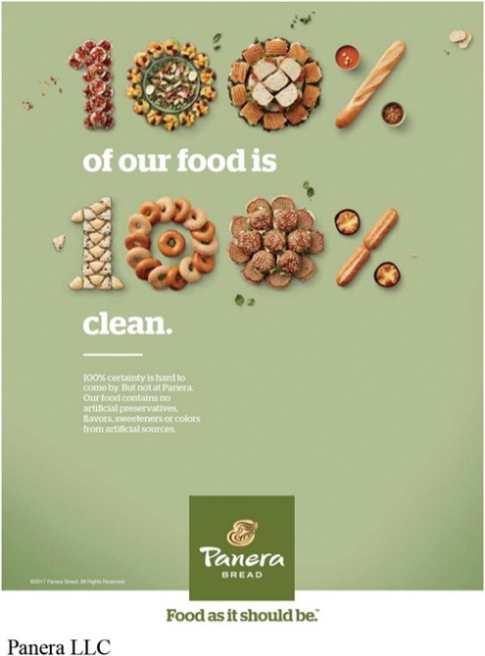
Market Segmentation (7 of 14)
Segmenting Consumer Markets
Psychographic segmentation divides a market into different segments based on social class, lifestyle, or personality characteristics.
Lifestyle segmentation: Panera caters to a healthy eating lifestyle segment of people who want more than just good-tasting food—they want food that’s good for them, too.
Notes:
Psychographic segmentation: Dunkin’ Donuts successfully targets the “Dunkin’ tribe”—not the Starbucks coffee snob but the average Joe. Dunkin’ Donuts isn’t like Starbucks—it doesn’t want to be.”
People in the same demographic group can have very different psychographic characteristics.
In Chapter 5, we discussed how the products people buy reflect their lifestyles. Marketers also use personality variables to segment markets. For example, different soft drinks target different personalities. Mountain Dew projects a youthful, rebellious, adventurous personality whereas Coca-Cola Zero appeals to target personality types which are more mature, practical, and cerebral but good-humored. Its subtly humorous ads promise “Real Coca-Cola taste and zero calories.”

Slide 14
Market Segmentation (8 of 14)
Segmenting Consumer Markets
Behavioral segmentation divides a market into segments based on consumer knowledge, attitudes, uses of a product, or responses to a product.
Notes:
Many marketers believe that behavior variables are the best starting point for building market segments.

Slide 15
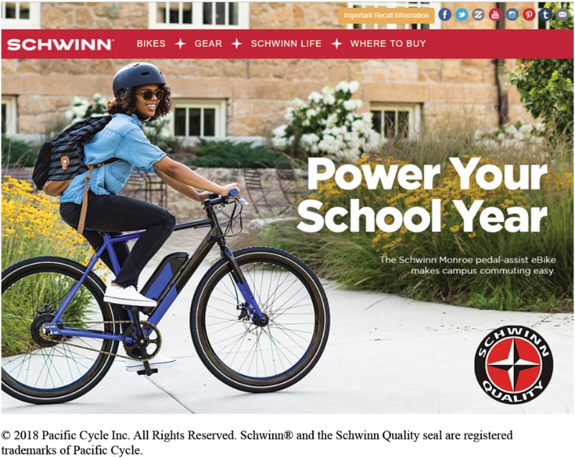
Market Segmentation (9 of 14)
Segmenting Consumer Markets
Behavioral Segmentation
Occasions
Benefits sought
User status
Usage rate
Loyalty status
Benefit segmentation: Schwinn makes bikes for every benefit segment. For example, its e-bikes “help make the morning commute or ride around town a little bit easier.”
Notes:
Benefit segmentation: Schwinn makes bikes for every benefit segment. For example, Schwinn’s urban bikes are “for riders who want a functional, durable, and stylish bike to commute or ride casually in urban areas.”
Occasions refer to when consumers get the idea to buy, actually make their purchase, or use the purchased item. Occasion segmentation can help firms build up product usage. Campbell’s advertises its soups more heavily in the cold winter months, and Home Depot runs special springtime promotions for lawn and gardens products. Other marketers prepare special offers and ads for holiday occasions or nontraditional occasions.
Benefits sought refers to finding the major benefits people look for in a product class, the kinds of people who look for each benefit, and the major brands that deliver each benefit.
Markets can be segmented by user status: nonusers, ex-users, potential users, first-time users, and regular users of a product. Marketers want to reinforce and retain regular users, attract targeted nonusers, and reinvigorate relationships with ex-users.
Markets can also be segmented by usage rate: light, medium, and heavy product users. Heavy users are often a small percentage of the market but account for a high percentage of total consumption. For instance, a recent study showed that heavy seafood consumers in the United States are a small but hungry bunch. Less than 5 percent of all shoppers buy nearly 64 percent of unbreaded seafood consumed in the United States.
Consumers can be loyal to brands, and buyers can be divided into groups according to their degree of loyalty. Some consumers are completely loyal—they buy one brand all the time and can’t wait to tell others about it. Other consumers are somewhat loyal—they are loyal to two or three brands of a given product or favor one brand while sometimes buying others. Still other buyers show no loyalty to any brand—they either want something different each time they buy, or they buy whatever’s on sale. A company can learn a lot by analyzing loyalty patterns in its market, starting with its own loyal customers.

Slide 16
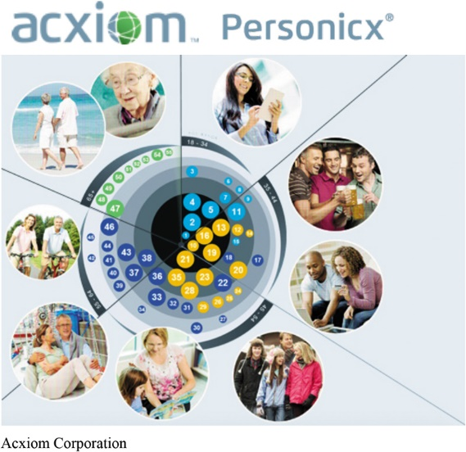
Market Segmentation (10 of 14)
Segmenting Consumer Markets
Multiple segmentation is used to identify smaller, better-defined target groups.
Experian’s Mosaic U S A system classifies U.S. households into one of 71 lifestyle segments and 19 levels of affluence.
Using Acxiom’s Personicx segmentation system, marketers paint a surprisingly precise picture of who you are and what you buy. Personicx clusters carry such colorful names as “Skyboxes and Suburbans,” “Shooting Stars,” “Hard Chargers,” “Soccer and SUVs,” “Raisin’ Grandkids,” “Truckin’ and Stylin’,” “Pennywise Mortgagees,” and “Cartoons and Carpools.”
Notes:
Marketers rarely limit their segmentation analysis to only one or a few variables. Rather, they often use multiple segmentation bases in an effort to identify smaller, better defined target groups. Several business information services like Experian provide multivariable segmentation systems that merge geographic, demographic, lifestyle, and behavioral data to help companies segment their markets down to zip codes, neighborhoods, and even households.
Using Acxiom’s Personicx segmentation system, marketers paint a surprisingly precise picture of who you are and what you buy. Personicx clusters carry such colorful names as “Skyboxes and Suburbans,” “Shooting Stars,” “Hard Chargers,” “Soccer and SUVs,” “Raisin’ Grandkids,” “Truckin’ and Stylin’,” “Pennywise Mortgagees,” and “Cartoons and Carpools.”
Such rich segmentation provides a powerful tool for marketers of all kinds. It can help companies identify and better understand key customer segments, reach them more efficiently, and tailor market offerings and messages to their specific needs.

Slide 17
Market Segmentation (11 of 14)
Segmenting Business Markets
Consumer and business marketers use many of the same variables to segment their markets.
Additional variables include:
Customer operating characteristics
Purchasing approaches
Situational factors
Personal characteristics
Notes:
Consumer and business marketers can be segmented geographically, demographically (industry, company size), or by benefits sought, user status, usage rate, and loyalty status. Yet, business marketers also use some additional variables.
Almost every company serves at least some business markets. For example, Starbucks has developed distinct marketing programs for each of its two business segments: the office coffee and food service segments.
Many companies establish separate systems for dealing with larger or multiple-location customers. For example, Steelcase, a major producer of office furniture, first divides customers into seven segments, and salespeople work with independent Steelcase dealers to handle smaller, local, or regional Steelcase customers in each segment.
Many national, multiple-location customers, such as ExxonMobil or IBM, have special needs that may reach beyond the scope of individual dealers. Therefore, Steelcase uses national account managers to help its dealer networks handle national accounts.

Slide 18
Market Segmentation (12 of 14)
Segmenting International Markets
Geographic location
Economic factors
Political and legal factors
Cultural factors
Notes:
Few companies have either the resources or the will to operate in all, or even most, of the countries that dot the globe. Operating in many countries presents new challenges. Different countries, even those that are close together, can vary greatly in their economic, cultural, and political makeup. International firms need to group their world markets into segments with distinct buying needs and behaviors. Companies can segment international markets using one or a combination of several variables:
Geographic location involves grouping countries by regions such as Western Europe, the Pacific Rim, the Middle East, or Africa. Geographic segmentation assumes that nations close to one another will have many common traits and behaviors, however there are many exceptions. For example, the Dominican Republic is no more like Brazil than Italy is like Sweden. Many Central and South Americans don’t even speak Spanish.
Economic factors involve grouping countries by population income levels or by their overall level of economic development. A country’s economic structure shapes its population’s product and service needs and, therefore, the marketing opportunities it offers.
Political and legal factors involve segmenting by the type and stability of the government, government receptivity to foreign firms, monetary regulations, and the amount of bureaucracy.
Cultural factors involve grouping markets according to common languages, religions, values and attitudes, customs, and behavioral patterns.

Slide 19
Market Segmentation (13 of 14)
Segmenting International Markets
Intermarket segmentation involves forming segments of consumers who have similar needs and buying behaviors even though they are located in different countries.
Notes:
Segmenting international markets based on geographic, economic, political, cultural, and other factors presumes that segments should consist of clusters of countries.
However, as new communications technologies, such as satellite TV and the internet, connect consumers around the world, marketers can define and reach segments of like-minded consumers no matter where in the world they are using intermarket segmentation (also called cross-market segmentation.)

Slide 20
Market Segmentation (14 of 14)
Requirements for Effective Segmentation
Measurable
Accessible
Substantial
Differentiable
Actionable
Notes:
Measurable: The size, purchasing power, and profiles of the segments can be measured.
Accessible: The market segments can be effectively reached and served.
Substantial: The market segments are large or profitable enough to serve.
Differentiable: The segments are conceptually distinguishable and respond differently to different marketing mix elements and programs.
Actionable: Effective programs can be designed for attracting and serving the segments.

Slide 21
Learning Objective 3
Explain how companies identify attractive market segments and choose a market-targeting strategy.
Notes:
After dividing the market into segments, it’s time to answer that first seemingly simple marketing strategy question we raised in Figure 7.1: Which customers will the company serve?
The firm now has to decide how many and which segments it can serve best. We now look at how companies evaluate and select target segments.

Slide 22
Market Targeting (1 of 10)
Evaluating Market Segments
Segment size and growth
Segment structural attractiveness
Company objectives and resources
Notes:
Selecting segments that have the right size and growth characteristics is a relative matter. The largest, fastest-growing segments are not always the most attractive ones for every company. Smaller companies may target segments that are smaller and less attractive, in an absolute sense, but that are potentially more profitable for them.
Structural factors that affect long-run segment attractiveness include strong and aggressive competitors, new entrants, substitute products, power of buyers relative to sellers, and powerful suppliers who can control prices, quality, or quantity of ordered goods and services.
Some attractive segments can be dismissed quickly because they do not mesh with the company’s long-run objectives. Or the company may lack the skills and resources needed to succeed in an attractive segment. A company should only enter segments in which it can create superior customer value and gain advantages over its competitors.

Slide 23
Market Targeting (2 of 10)
Selecting Target Market Segments
A target market is a set of buyers who share common needs or characteristics that the company decides to serve.
Notes:
After evaluating different segments, the company must decide which and how many segments it will target. Market targeting can be carried out at several different levels as shown in the next slide.

Slide 24
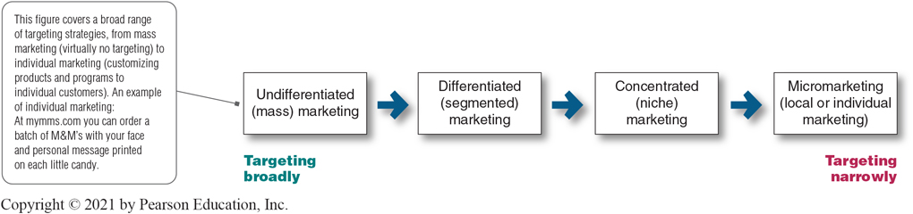
Market Targeting (3 of 10)
Figure 7.2 Market-Targeting Strategies
Notes:
Figure 7.2 shows that companies can target very broadly (undifferentiated marketing), very narrowly (micromarketing), or somewhere in between (differentiated or concentrated marketing).
This figure covers a broad range of targeting strategies, from mass marketing (virtually no targeting) to individual marketing (customizing products and programs to individual customers). An example of individual marketing is candy lovers can buy M&M’s embossed with images of their kids or pets.
Long Description:
The details depicted in the flowchart are as follows:
The strategies that follow move from Targeting broadly to targeting narrowly.
Undifferentiated (mass) marketing
Differentiated (segmented) marketing
Concentrated (niche) marketing
Micromarketing (local or individual marketing)
Note: This figure covers a broad range of targeting strategies, from mass marketing (virtually no targeting) to individual marketing (customizing products and programs to individual customers).

Slide 25
Market Targeting (4 of 10)
Selecting Target Market Segments
Undifferentiated marketing targets the whole market with one offer.
Mass marketing
Focuses on common needs rather than what’s different
Notes:
With undifferentiated marketing (or mass marketing), the company designs a product and a marketing program that will appeal to the largest number of buyers.
As noted in the chapter, most modern marketers have strong doubts about this strategy. Difficulties arise in developing a product or brand that will satisfy all consumers. Moreover, mass marketers often have trouble competing with more-focused firms that do a better job of satisfying the needs of specific segments and niches.

Slide 26
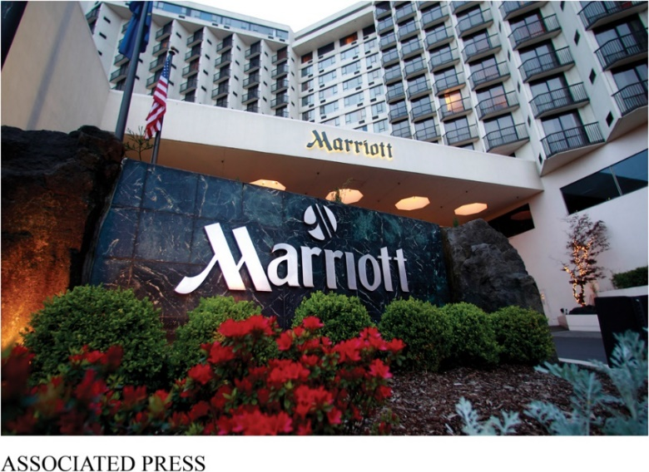
Market Targeting (5 of 10)
Selecting Target Market Segments
Differentiated marketing targets several different market segments and designs separate offers for each.
Goal is to achieve higher sales and stronger position
More expensive than undifferentiated marketing
Differentiated marketing: With more than 30 differentiated hotel brands, Marriott International dominates the hotel industry, capturing a much larger share of the travel and hospitality market than it could with any single brand alone.
Notes:
Ritz-Carlton, St. Regis, and W Hotels serve the luxury segment. The Marriott, Sheraton, and Westin brands serve more mainstream but still upscale travelers. Courtyard by Marriott focuses on more affordable rooms for business travelers, and Residence Inn by Marriott targets extended-stay business and leisure travelers. Aloft offers “an affordable alternative for the tech-savvy and confidently social—travelers who love open spaces, open thinking, and open expression.” The Marriott Vacation Club gives travelers a timeshare option.
In all, the Marriott portfolio of brands offers something for every travel segment.
Differentiated marketing increases the costs of doing business. The company must weigh increased sales against increased costs when deciding on a differentiated marketing strategy.

Slide 27
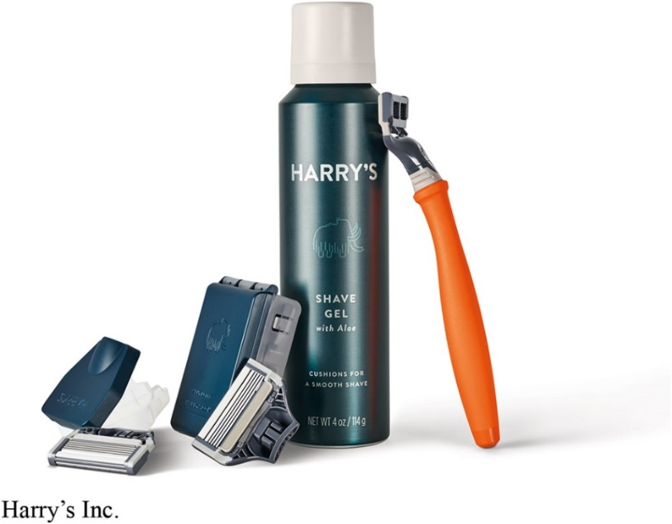
Market Targeting (6 of 10)
Selecting Target Markets
Concentrated marketing targets a large share of a smaller market.
Limited company resources
Knowledge of the market
More effective and efficient
Concentrated marketing: Nicher Harry’s concentrates its resources on direct-to-consumer sales of high-quality razors and shaving products to a value- and convenience-oriented segment of buyers previously not well served by giant competitors like Gillette.
Notes:
Concentrated marketing: When using a concentrated marketing (or niche marketing) strategy, a firm goes after a large share of one or a few smaller segments or niches. For example, Stance Socks thrives with high-quality, colorful socks sold through high-end department stores.
Today, the low cost of setting up shop on the internet makes it even more profitable to serve seemingly miniscule niches. Small businesses, in particular, are realizing riches from serving small niches on the eb.
Concentrated marketing can be highly profitable. At the same time, it involves higher-than-normal risks. Companies that rely on one or a few segments for all of their business will suffer greatly if the segment turns sour. Or larger competitors may decide to enter the same segment with greater resources. For these reasons, many companies prefer to diversify in several market segments. In fact, many large companies develop or acquire niche brands of their own.

Slide 28
Market Targeting (7 of 10)
Selecting Target Market Segments
Micromarketing is the practice of tailoring products and marketing programs to suit the tastes of specific individuals and locations.
Local marketing
Individual marketing
Notes:
Rather than seeing a customer in every individual, micromarketers see the individual in every customer. Micromarketing includes local marketing and individual marketing described on the next slides.

Slide 29
Market Targeting (8 of 10)
Selecting Target Market Segments
Local marketing involves tailoring brands and promotion to the needs and wants of local customer segments.
Cities
Neighborhoods
Stores
Notes:
Local marketing involves tailoring brands and promotions to the needs and wants of local customer groups—cities, neighborhoods, and even specific stores. For example, department store chain Macy’s has rolled out a localization program called My Macy’s in which merchandise is customized under 69 different geographical districts.
Advances in communications technology have given rise to new high-tech versions of location-based marketing. Thanks to the explosion in net-connected
smartphones with GPS capabilities and location-based social networks, companies can now track consumers’ whereabouts closely and gear their offers accordingly.
Increasingly, location-based marketing is going mobile, reaching on-the-go consumers as they come and go in key local market areas.
Discussion Question
What are the drawbacks of local marketing?
Local marketing has some drawbacks. It can drive up manufacturing and marketing costs by reducing the economies of scale. It can also create logistics problems as companies try to meet the varied requirements of different regional and local markets. Still, as companies face increasingly fragmented markets, and as new supporting technologies develop, the advantages of local marketing often outweigh the drawbacks. In addition, a brand’s overall image might be diluted if the product and message vary too much in different localities.

Slide 30
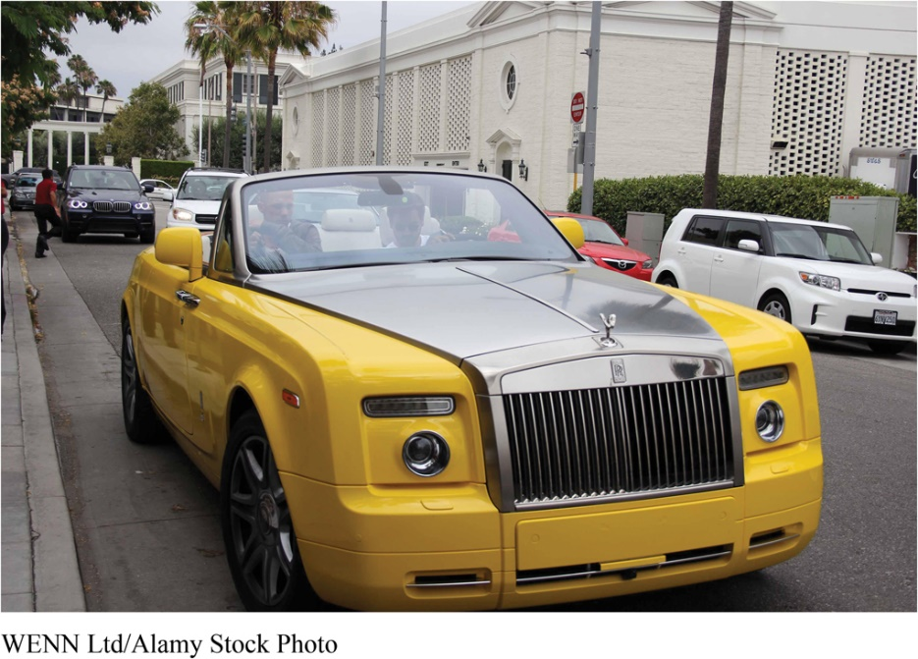
Market Targeting (9 of 10)
Selecting Target Markets
Individual marketing involves tailoring products and marketing programs to the needs and preferences of individual customers.
Also known as:
One-to-one marketing
Mass customization
Individual marketing: The Rolls-Royce Bespoke design team works closely with individual customers to help them create their own unique Rolls-Royces.
Notes:
In the extreme, micromarketing becomes individual marketing—one-to-one or markets-of-one marketing.
More detailed databases, robotic production and flexible manufacturing, and interactive media such as mobile phones and the internet have combined to foster mass customization. Mass customization is the process by which firms interact one-to-one with masses of customers to design products and services tailor-made to individual needs. Individual marketing has made relationships with customers more important than ever.
The world appears to be coming full circle—from the good old days when customers were treated as individuals to mass marketing when nobody knew your name and then back again.

Slide 31
Market Targeting (10 of 10)
Selecting Target Market Segments
Choosing a targeting strategy depends on
Company resources
Product variability
Product life-cycle stage
Market variability
Competitor’s marketing strategies
Notes:
As shown in the slide, companies need to consider many factors when choosing a market-targeting strategy.
When the firm’s resources are limited, concentrated marketing makes the most sense. Undifferentiated marketing is more suited for uniform products, such as grapefruit or steel.
When a firm introduces a new product, it may be practical to launch one version only, as undifferentiated marketing or concentrated marketing may make the most sense. In the mature stage of the product life cycle, however, differentiated marketing often makes more sense.
Undifferentiated marketing is appropriate where there is little market variability – most buyers have the same tastes, buy the same amounts, and react the same way to marketing efforts.
When competitors use undifferentiated marketing, a firm can gain an advantage by using differentiated or concentrated marketing, focusing on the needs of buyers in specific segments.

Slide 32
Learning Objective 4
Discuss how companies differentiate and position their products for maximum competitive advantage.

Slide 33
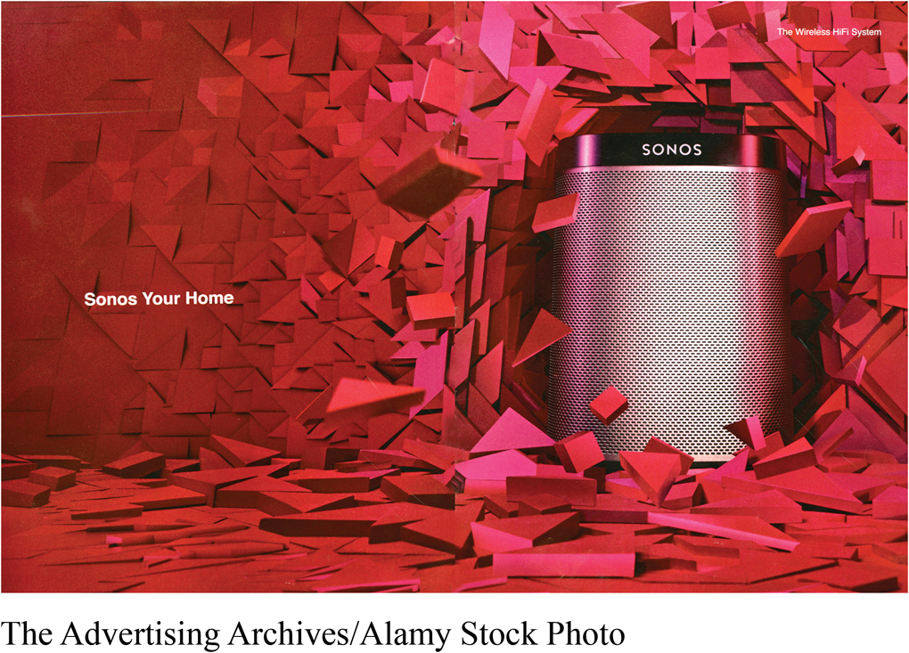
Differentiation and Positioning (1 of 9)
Product position is the way the product is defined by consumers on important attributes.
Positioning: Sonos does more than just sell speakers; it unleashes “All the music on earth, in every room of your house, wirelessly.”
Notes:
Positioning: Sonos does more than just sell speakers; it unleashes “All the music on earth, in every room of your house, wirelessly.”
The company must decide on a value proposition—how it will create differentiated value for targeted segments and what positions it wants to occupy in those segments. The place the product occupies in consumers’ minds relative to competing products is the position. Products are made in factories, but brands happen in the minds of consumers.
Dreft is positioned as the gentle detergent for baby clothes; at IHOP, you “Come hungry. Leave happy.”; at Olive Garden, “When You’re Here, You’re Family.” In the automobile market, the Nissan Versa and Honda Fit are positioned on economy, Mercedes and Cadillac on luxury, and Porsche and BMW on performance.
To simplify the buying process, consumers organize products, services, and companies into categories and “position” them in their minds. A product’s position is the complex set of perceptions, impressions, and feelings that consumers have for the product compared with competing products.
Consumers position products with or without the help of marketers. But marketers do not want to leave their products’ positions to chance. They must plan positions that will give their products the greatest advantage in selected target markets, and they must design marketing mixes to create these planned positions.

Slide 34
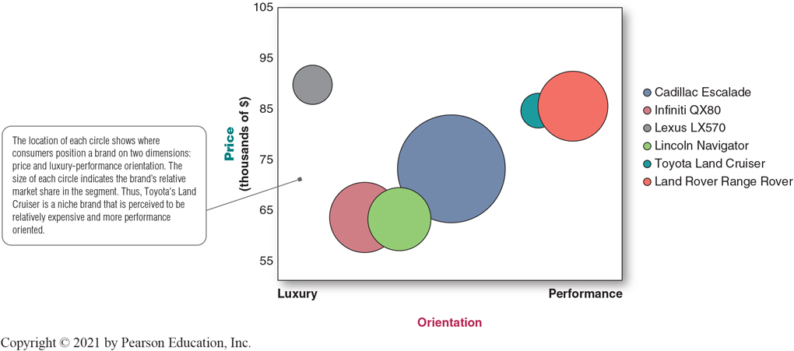
Differentiation and Positioning (2 of 9)
Positioning maps show consumer perceptions of marketer’s brands versus competing products on important buying dimensions.
Figure 7.3 Positioning map: Large luxury S U Vs
Notes:
In planning their differentiation and positioning strategies, marketers often prepare perceptual positioning maps. The position of each circle on the map indicates the brand’s perceived positioning on two dimensions: price and orientation (luxury versus performance). The size of each circle indicates the brand’s relative market share.
Long Description:
The horizontal axis shows the orientation from luxury on the left to performance on the right.
The vertical axis shows the price in thousands of dollars, marked from 45 to 105 in increments of 10.
The details of the different brands represented as circles denoting their share of the market, from the largest to the smallest, are as follows:
Cadillac Escalade
Orientation: midway on the horizontal axis
Price: 73,395
Land Rover Range Rover
Orientation: At right extreme, at performance
Price: 85,650
Infiniti Q X (has approximately the same market share as the Land Rover Range Rover)
Orientation: One-quarter away from luxury on the horizontal axis
Price: 63,850
Lincoln Navigator
Orientation: Between Infiniti Q X and Cadillac Navigator
Price: 63,515
Lexus L X 570
Orientation: Extreme left, at Luxury
Price: 89,880
Toyota Land Cruiser
Orientation: Toward the extreme right, just before the Land Rover Range Rover
Price: 84,775
Note: The location of each circle shows where consumers position a brand on two dimensions: price and luxury-performance orientation. The size of each circle indicates the brand’s relative market share in the segment. Thus, Toyota’s Land Cruiser is a niche brand that is perceived to be relatively expensive and more performance oriented.

Slide 35
Differentiation and Positioning (3 of 9)
Choosing a Differentiation and Positioning Strategy
Identifying a set of possible competitive advantages to build a position
Choosing the right competitive advantages
Selecting an overall positioning strategy
Communicating and delivering the chosen position to the market
Notes:
Firms must differentiate their offers by building a unique bundle of benefits that appeals to a substantial group within the segment. Above all else, a brand’s positioning must serve the needs and preferences of well-defined target markets.
For example, although both Dunkin’ Donuts and Starbucks are coffee and snack shops, they target very different customers, who want very different things from their favorite coffee seller. Starbucks targets more upscale professionals with more high-brow positioning. In contrast, Dunkin’ Donuts targets the “average Joe” with a decidedly more low-brow, “everyman” kind of positioning. Yet each brand succeeds because it creates just the right value proposition for its unique mix of customers.

Slide 36
Differentiation and Positioning (4 of 9)
Choosing a Differentiation and Positioning Strategy
Competitive advantage is an advantage over competitors gained by offering consumers greater value, either through lower prices or by providing more benefits that justify higher prices.
Notes:
To build profitable relationships with target customers, marketers must understand customer needs and deliver more customer value better than competitors do. To the extent that a company can differentiate and position itself as providing superior customer value, it gains competitive advantage.
But solid positions cannot be built on empty promises. If a company positions its product as offering the best quality and service, it must actually differentiate the product so that it delivers the promised quality and service. Companies must do much more than simply shout out their positions with slogans and taglines. They must first live the slogan.

Slide 37
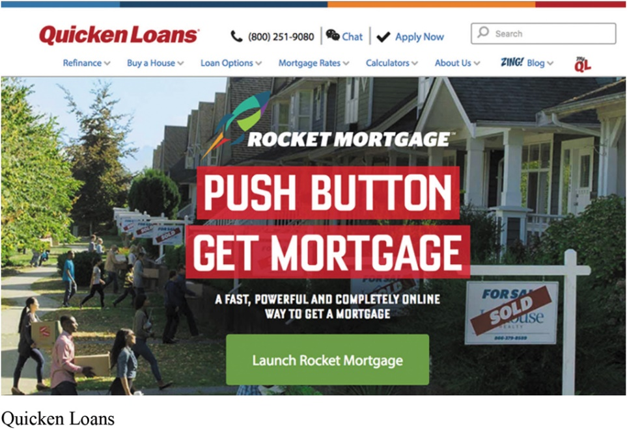
Differentiation and Positioning (5 of 9)
Choosing a Differentiation and Positioning Strategy
Identifying a set of possible competitive advantages to differentiate along the lines of:
Product
Services
Channels
People
Image
Services differentiation: Quicken Loans’ Rocket Mortgage doesn’t just offer mortgage loans; its online-only interface lets users get a loan decision in only minutes.
Notes:
To find points of differentiation, marketers must think through the customer’s entire experience with the company’s product or service. An alert company can find ways to differentiate itself at every customer contact point.
Through product differentiation, brands can be differentiated on features, performance, or style and design. Thus, Bose positions its speakers on their striking design and sound characteristics. By gaining the approval of the American Heart Association as an approach to a healthy lifestyle, Subway differentiates itself as the healthy fast-food choice.
Some companies gain services differentiation through speedy, convenient, or careful delivery. For example, Jimmy John’s doesn’t just offer fast food; its gourmet sandwiches are “Freaky Fast.”
Firms that practice channel differentiation gain competitive advantage through the way they design their channel’s coverage, expertise, and performance. Amazon.com and GEICO, for example, set themselves apart with their smooth-functioning direct channels.
Companies can also gain a strong competitive advantage through people differentiation—hiring and training better people than their competitors do.
Even when competing offers look the same, buyers may perceive a difference based on company or brand image differentiation. The chosen symbols, characters, and other image elements a brand chooses must be communicated through advertising that conveys the company’s or brand’s personality.

Slide 38
Differentiation and Positioning (6 of 9)
Choosing a Differentiation and Positioning Strategy
A competitive advantage should be:
Important
Distinctive
Superior
Communicable
Preemptive
Affordable
Profitable
Notes:
Discussion Question
Are you familiar with GEICO advertisements? If so, what is their positioning?
Not all brand differences are meaningful or worthwhile, and each difference has the potential to create company costs as well as customer benefits. A difference is worth establishing to the extent that it satisfies the following criteria:
Important: The difference delivers a highly valued benefit to target buyers.
Distinctive: Competitors do not offer the difference, or the company can offer it in a more distinctive way.
Superior: The difference is superior to other ways that customers might obtain the same benefit.
Communicable: The difference is communicable and visible to buyers.
Preemptive: Competitors cannot easily copy the difference.
Affordable: Buyers can afford to pay for the difference.
Profitable: The company can introduce the difference profitably.
Many companies have introduced differentiations that failed one or more of these tests. Choosing competitive advantages on which to position a product or service can be difficult, yet such choices may be crucial to success. Choosing the right differentiators can help a brand stand out from the pack of competitors. For example, when Nokia introduced its Lumia 1020 smartphone, it didn’t position the phone only on attributes shared with competing models, such as user interface and speed. It positioned it as a smartphone with a 41 megapixel camera with a “reinvented zoom” and “full HD video” that fits today’s digital lifestyles.

Slide 39
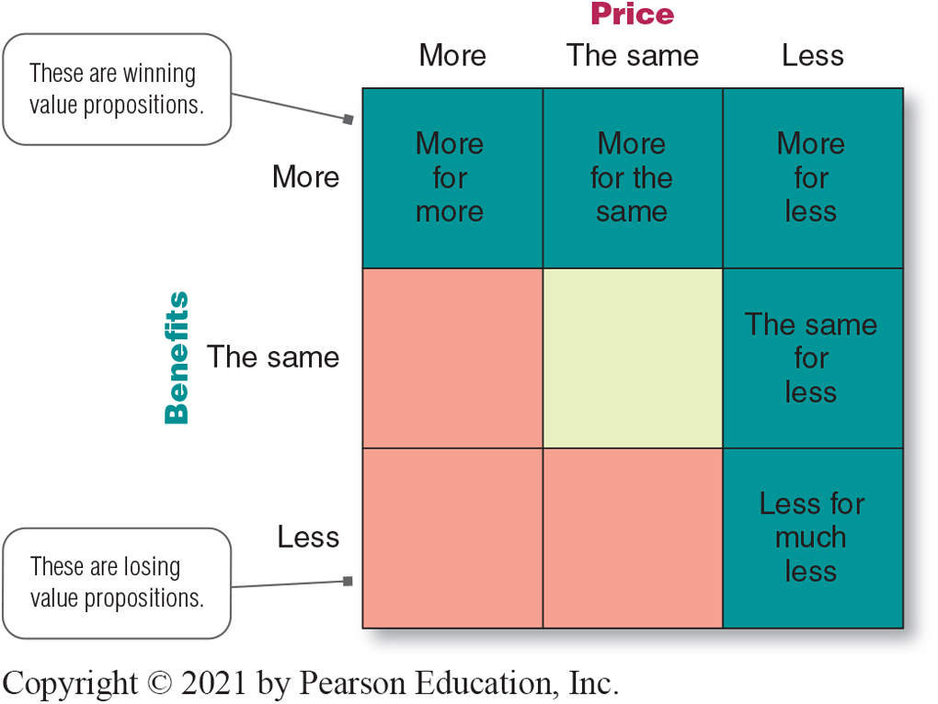
Differentiation and Positioning (7 of 9)
Choosing a Differentiation and Positioning Strategy
Value proposition is the full mix of benefits upon which a brand is positioned.
Figure 7.4 Possible Value Propositions
Notes:
The full positioning of a brand is called the brand’s value proposition—the full mix of benefits on which a brand is differentiated and positioned. It is the answer to the customer’s question “Why should I buy your brand?” BMW’s “ultimate driving machine” value proposition hinges on performance but also includes luxury and styling, all for a price that is higher than average but seems fair for this mix of benefits.
Figure 7.4 shows possible value propositions on which a company might position its products. In the figure, the five green cells represent winning value propositions— differentiation and positioning that gives the company a competitive advantage.
More for more: This positioning involves providing the most upscale product or service and charging a higher price to cover the higher costs. Although more for more can be profitable, this strategy can also be vulnerable. It often invites imitators who claim the same quality but at a lower price.
More for the same: Companies can attack a competitor’s more for more positioning by introducing a brand offering comparable quality at a lower price. For example, Toyota introduced its Lexus line with a more for the same value proposition versus Mercedes and BMW.
The same for less: Offering the same for less can be a powerful value proposition—everyone likes a good deal. Discount stores such as Walmart and “category killers” such as Best Buy, PetSmart, David’s Bridal, and DSW Shoes use this positioning.
Less for much less: A market almost always exists for products that offer less and therefore cost less. Few people need, want, or can afford “the very best” in everything they buy. In many cases, consumers will gladly settle for less than optimal performance or give up some of the bells and whistles in exchange for a lower price. For example, Family Dollar and Dollar General stores offer more affordable goods at very low prices.
More for less: Of course, the winning value proposition would be to offer more for less. Many companies claim to do this. And, in the short run, some companies can actually achieve such lofty positions. For example, when it first opened for business, Home Depot had arguably the best product selection, the best service, and the lowest prices compared to local hardware stores and other home improvement chains. Offering more usually costs more, making it difficult to deliver on the “for less” promise in the long run.
All said, each brand must adopt a positioning strategy designed to serve the needs and wants of its target markets. More for more will draw one target market, less for much less will draw another, and so on. Thus, in any market, there is usually room for many different companies, each successfully occupying different positions. The important thing is that each company must develop its own winning positioning strategy, one that makes the company special to its target consumers.
Long Description:
The grid figure has nine cells placed in a 3 by 3 formation.
Horizontally the three columns show the price, from the left to the right, as more; the same; and less.
Vertically the three rows show benefits, from bottom to the top, as less; the same; and more.
The three cells on the top row are colored green and labeled, from the left, as: more for more; more for the same; and more for less.
The three cells in the middle row are colored, from the left, pink, yellow, and green, with the green cell labeled, the same for less.
The three cells in the bottom row are colored, from the left, pink, pink, and green, with the green cell labeled, less for much less.
All the green cells are marked: These are winning propositions.
All the pink cells are marked: These are losing value propositions.

Slide 40
Differentiation and Positioning (8 of 9)
Choosing a Differentiation and Positioning Strategy
Positioning statement summarizes company or brand positioning using this form: To (target segment and need) our (brand) is (concept) that (point of difference)
Notes:
The company and brand positioning should be summed up in a positioning statement. An example using the above form is shown on the next slide.
The case for the brand’s superiority is made on its points of difference. For example, the U.S. Postal Service ships packages just like UPS and FedEx, but it differentiates its priority mail from competitors with convenient, low-price, flat-rate shipping boxes and envelopes. “If it fits, it ships,” promises USPS.

Slide 41
Differentiation and Positioning (9 of 9)
Communicating and Delivering the Chosen Position
Choosing the positioning is often easier than implementing the position.
Establishing a position or changing one usually takes a long time.
Maintaining the position requires consistent performance and communication.
Notes:
Once it has chosen a position, the company must take strong steps to deliver and communicate the desired position to its target consumers. All the company’s marketing mix efforts must support the positioning strategy. Positioning the company calls for concrete action, not just talk. If the company decides to build a position on better quality and service, it must first deliver that position.
Companies must closely monitor and adapt the position over time to match changes in consumer needs and competitors’ strategies. However, the company should avoid abrupt changes that might confuse consumers, and should evolve gradually as it adapts to the ever-changing marketing environment.

Slide 42

Copyright
This work is protected by United States copyright laws and is provided solely for the use of instructors in teaching their courses and assessing student learning. Dissemination or sale of any part of this work (including on the World Wide Web) will destroy the integrity of the work and is not permitted. The work and materials from it should never be made available to students except by instructors using the accompanying text in their classes. All recipients of this work are expected to abide by these restrictions and to honor the intended pedagogical purposes and the needs of other instructors who rely on these materials.

